Slide 1
STUDENT ORIENTATION
Undergraduate Programs
Trimester 3 2024
A very warm welcome to our New Students from the UBSS Staff.

Slide 2
Welcome to The undergraduate
Bachelor of Accounting and Bachelor of Business Orientation
Associate Professor
Wayne Smithson MBA, CPA, FILM

Slide 3
Today’s Topics
Overview
Commitments
The Bachelor of Accounting and Bachelor of Business Programs
Choosing your Subjects
Subject Exemptions
Our objective – to assist you in being “work ready”
Capstone
Academic Integrity

Slide 4
Associate Professor Wayne Smithson
Program Director – Undergraduate programs
Over 40 years of commercial experience
Over 15 years of academic experience
Associate Member Securities Institute of Australia
Certified Practicing Accountant (CPA)
Fellow of Institute of Managers and Leaders (FIML)
Associate Professor Wayne Smithson
Program Director
(Undergraduate Program)
Wayne.Smithson@ubss.edu.au

Slide 5
Introduction to UBSS
This is a business school offering Higher Education and Degree qualifications
Our commitment:
We will prepare you to be work ready in the business world in your respective discipline
It is the College's objective to have you work ready by completion of your degree
This means we need a commitment from you!
Source: The Australian Government Department of Education and Training Quality Indicators for Learning and Teaching - qilt.edu.au

Slide 6
Your Commitment
Attend all classes. Attendance records are taken each week and will be monitored
Complete and submit all assessments
Be respectful and attentive in class
Participate in class – asking questions is key to learning
Undertake at least 3 hours study outside of the face-to-face teaching hours for each subject
Buy the textbook for your subject as identified in the subject outline
Use the e-library

Slide 7
Assessments
There are a minimum of 3 assessments for each subject, typically
Group or Individual Assignment (typically Week 10)
Class assessments or quizzes
Class participation
Assessments
All grade reviews are to be referred to your lecturer in the first instance
On/line quiz are held in class and there are no resists for these invigilated assessments

Slide 8
Subject Outlines
Subject outlines provide you with information about the subject you are enrolled in for the trimester
It is important you read this for each subject for which you are enrolled
It will be in the first section of the Moodle page
Subject Outlines contain information about:
Assessments
Details of each week study
Textbooks
Information on readings in the e-learning data base

Slide 9
Moodle
The Moodle database provides you with access to majority of the subject information including:
Weekly Lecture slides
Practice Question and Answers
Advice from the Lecturer
Readings placed there by your Lecturer
Subject Outline
Please ensure you open up the Moodle site for each subject, if you do not, you will not be formally registered in the course

Slide 10
Moodle
Moodle will give you access to:
Subject Outlines
Readings and Lecture Recordings
Access and submission of Assignments
Grades and Marks
E-library
Moodle can be accessed through your Student Central found on the UBSS website.
https://www.ubss.edu.au/student-central/

Slide 11
Satisfactory Academic Progression
You must attend all Lectures
You must commit to the Subject
You must successfully complete all assessments
Please Read the UBSS policy on satisfactory Academic Progress

Slide 12
Academic Support
Academic support is available on daily basis through:
Your Lecturer in the first instance
Your Academic Learning Support coordinator
Myself as program Director
I am on campus on Monday to Thursday
If you need to discuss your academic progress, please make an appointment through the UBSS App, I am available

Slide 13
Course Structure prerequisites
Check the course structure of the Bachelor of Business and Accounting
Follow the proper sequence of subjects as some subjects have pre-requisites
Ensure that you choose first year Subjects only in your first trimester

Slide 14
Course Structure Accounting
Year 1
Advanced Business Communication
Principles of Accounting
Quantitative Methods
Accounting for Business
Business Economics
IT for Accountants
Organisational Behaviour
Corporate finance

Slide 15
Course Structure
Year 2
Business Law
Management Accounting
Stakeholder Value and Ethics
Issues in Financial Reporting
Company and Associations Law
Dimensions of the Knowledge Society
Accounting Information Systems
Taxation Law and Practice 1

Slide 16
Course Structure
Year 3
Taxation Law and practice 2
Cost Management
Innovation and Entrepreneurship
Corporate Accounting
Auditing And Assurance
Financial Statement and Investment Analysis
Financial Accounting Theory
Capstone

Slide 17
Course Structure Business
Year 1
Advanced Business Communication
Principles of Accounting
Quantitative Methods
Accounting for Business
Business Economics
Marketing Fundamentals
Cross Cultural Management
Management Principles

Slide 18
Course Structure Business
Year 2
Business Law
Organisational Behaviour
Operations Management
Project Management
Dimensions of the Knowledge Society
Management Information Systems
Marketing Management
Risk Management

Slide 19
Course Structure Business
Year 3
Strategic Management
Team Leadership and Change Management
Innovation and Entrepreneurship
International Business Management
E-Business Management
Corporate Entrepreneurship, Leadership and Sustainability
Ethics and Social Responsibility
Capstone

Slide 20
Subject Exemptions
Review the Subjects in your degree to see if you potentially have any possible subject exemptions
In order to obtain an exemption for one or more subjects, you must:
Identify the Subjects you believe you are entitled to receive exemption
Complete the online submission and upload it to the correct area, if unsure, make an appointment to see Student Services to seek assistance
Provide supporting evidence that you have undertaken prior study in that subject

Slide 21
Subject Exemptions
You must provide evidence so that this can be assessed properly
If the documents are copies, they must be certified as true records, or the originals must be sighted
You can only apply for exemptions in your first trimester
Please note:
You cannot ask for exemptions for 3rd year Subjects unless you have completed a similar subject with an Australian Higher Education provider
The maximum exemptions you may be entitled to are 12 Subjects. This will depend on the previous Subjects you have successfully completed
Please complete Within 2 weeks of the commencement of the trimester
Applications in Week 1 and Decisions in Week 2 of trimester

Slide 22
Subject Selection
Lodge your selection form online
Subject selection:
When you access myGCA, go to Subject Selection in the menu
You will have a list of specific Subjects to choose from
Choose the Subjects that are available that most suit you

Slide 23
Learning Staff Roles
The Facilitator will be responsible for:
Delivering the tutorial materials
Invigilating in-class assessments for their subject cohort
Mark all assessments
The Learning Support Coordinator will be responsible for:
Supporting students' academic growth and success
Providing tailored learning assistance
At Sydney, the LSC is Wilhelmina Woortman
wilhelmina.woortman@ubss.edu.au

Slide 24
Learning Support Coordinator
The Learning Support Coordinators have developed workshops to assist you in your learning.

Slide 25
Being Work Ready
Our objective at UBSS is to assist you to become work ready
Your journey to become work ready starts today
Take some time to sit down and plan your career and your pathway program for completing your degree
Choose your Subjects with your career plan in mind
Being work ready means:
Learning current business theory and practices
Applying these at a domestic and global business community level
Developing your skills in the practical application of these theories and practices to real life business situations
Developing both academic and business networks

Slide 26
Business Networks
Developing a business network is essential in today’s business world to achieve a successful career
UBSS has an association with the Institute of Managers and Leaders (IML)
IML has a student membership program which provides a number of benefits to student members
The program provides student membership for a limited number of students
Use of nationally accredited post nominals, which can be used on your resume, communication materials
Access to the IML Internship program
Young Leaders Recognition program
AIM Leadership matters program on-line

Slide 27
Business Networks
UBSS also has an association with the Australian Computer Society (ACS)
ACS has a student membership program which provides a number of benefits to student members
Access to the materials on the ACS Website
Invitation to networking events
Free Student Memberships are available to all UBSS students

Slide 28
Professional Accreditations

Slide 29
Capstone – Experiential Learning
The Business Simulation Game (BSG) is used as a focal point to develop real life work scenarios
You must pass this final year subject to obtain your Degree
The teams are required to present an overview of the organisation's performance in the BSG
Presentations are done in a Board Room environment to lecturers and externals who have both extensive academic and commercial experience
Students are challenged and coached on dealing with real life scenarios across a number of critical business operations and functions

Slide 30
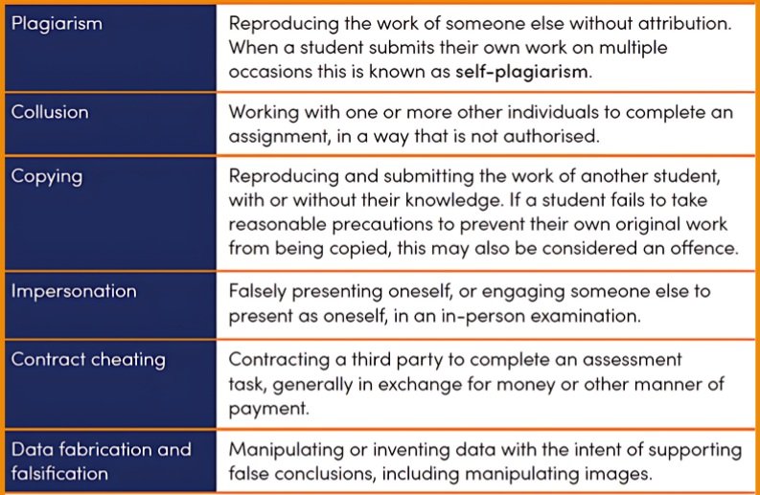
Academic Integrity
Academic Integrity is valued at UBSS.
Academic misconduct at UBSS is overseen by the ACADEMIC INTEGRITY COMMITTEE that will apply penalties and sanctions for misbehavior.
Please ensure you are familiar with the ACADEMIC MISCONDUCT POLICY located on the UBSS website:
https://www.ubss.edu.au/policies-and-procedures
These are some forms of Academic Misconduct

Slide 31
Plagiarism in assessments will be managed by lecturers by checks with Turnitin.
Turnitin also reviews potential instances of AI.
PENALTIES WILL BE APPLIED AS FOLLOWS:

Slide 32
Word documents - digital footprints
Word documents have a feature which highlights various features of the document including:
The author
The time of the last update
The time taken to complete the document
The last, in particular, can identify the amount of time to complete the assessment
If the time is relatively quick in relation to the expected, then it implies possibly “a cut and paste” answer was used

Slide 33
Digital footprints in Word documents

Slide 34
Online quizzes
Assessment quizzes completed on Moodle provide two areas which are used by lecturers to detect academic misconduct
A link to Turnitin for similarity
A report on the response history on each question for each student
The lecturers use this to monitor the time taken to complete each question and the quiz in total

Slide 35
Quizzes - monitoring information

Slide 36
Online assessment – digital recognition
UBSS can identify the IP address being used by students completing assessments
The IP address is unique to the computer access point on the internet
If two students use the same computer at the same time, it can be proven that the students colluded on the assessment.
This means that if other identification methods indicate that there is a potential collaboration between students, this is a potential issue of academic misconduct and penalties will apply.

Slide 37
Guidelines for online assessments:

Slide 38
Policies and Procedures
You can find all UBSS Policies and Procedures on our website.
ubss.edu.au

Slide 39
www.ubss.edu.au

