Slide 1



STUDENT ORIENTATION
Master of Business Administration

Slide 2

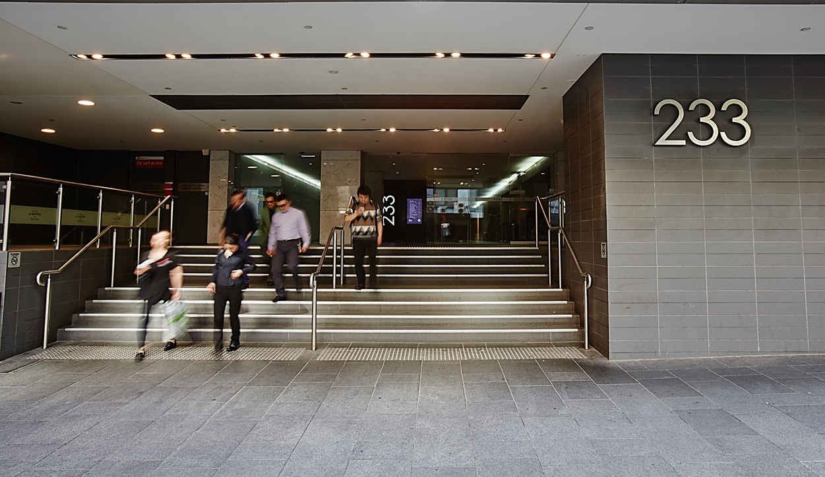
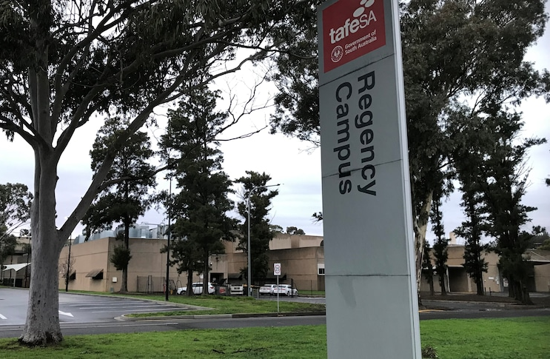

Welcome to MBA Orientation
Sydney Campus
Level 10 & 11 233 Castlereagh Street
Sydney NSW 2000
Independent MBA Business School
Melbourne, Sydney, Adelaide
Melbourne Campus
Level 2, 222 Bourke St
Melbourne VIC 3000
Adelaide Campus
137 Days Road
Regency Park Adelaide, SA 5010

Slide 3
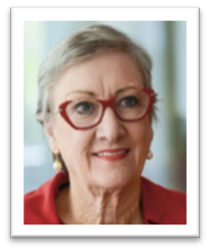
Welcome Message
Education is valued by communities across the world for its impact on individuals, their families and the societies in which they live and work.
By enrolling in your course you have already made the choice to make that impact – Congratulations!
Group Colleges Australia are privileged to welcome you to UBSS and proud that we are able to prepare you to create that impact.
Your study with UBSS for this trimester and as you journey through to graduation, will be supported by educators who are committed to your success and who understand the importance of your study experience for your entry as professionals to the international business world.
Your lecturers and facilitators have expert business and accounting knowledge and experience and will twin their skills with those of the specialised learning support faculty.
It is our commitment to you to ensure your professional ambitions are realised and we look forward to connecting you with your lecturers, learning support professionals, peers and the UBSS community across Australia in the modern and well-appointed campuses in Sydney, Melbourne and Adelaide.
We look forward to welcoming you and supporting your career success.
We will have a full onsite presence in Trimester 3, 2024.
Ruth Ferraro PhD, GAICD, FGIA
Interim President at Group Colleges Australia

Slide 4
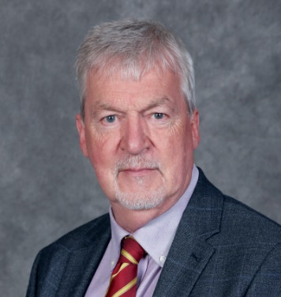
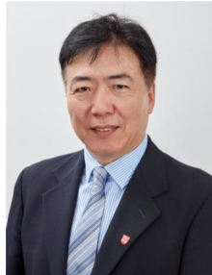
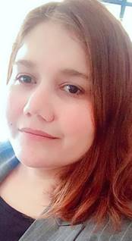
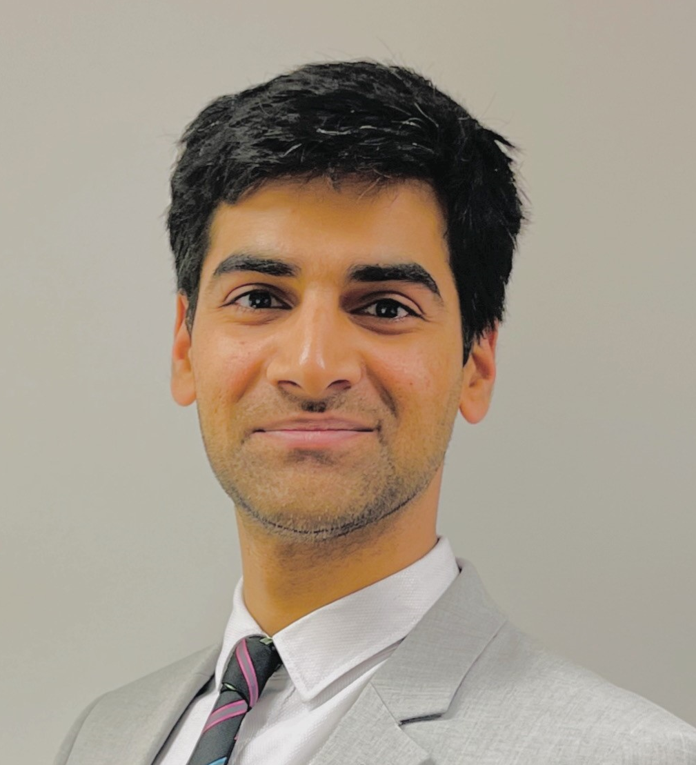
Associate Professor Tom O’Connor
Acting Executive Dean UBSS
Program Director (Postgraduate Program)
Associate Professor Richard Xi
Associate Program Director (Postgraduate Program) Sydney Campus
Associate Professor Aqeel Asad
Acting Campus Director
Adelaide Campus
Wajeeha Butt
Senior Postgraduate Administration Coordinator Sydney Campus

Slide 5
Today’s Topics
Overview
Commitments
The Master of Business Administration Program
MBA Subject Selections
Academic Integrity

Slide 6
Introduction to UBSS
  UBSS is one of the largest MBA schools (6th) in Australia (MBA News, 2020 statistics).
  Mission
  UBSS launches careers for the entrepreneurs of the future
  Motto
  ‘International Education with an Australian Experience’.

Slide 7
Introduction to UBSS
This is a MBA business school offering Higher Education and Degree qualifications (MBA; B. Accounting; B. Business).
UBSS is equipped with the state-of-the-art technology in subject delivery, online learning, and online services.

Slide 8
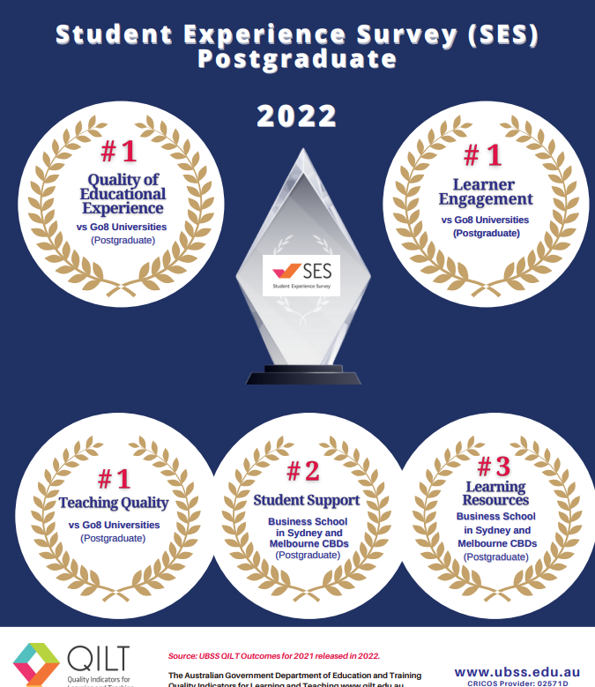
2022 QILT

Slide 9




Professional Accreditations

Slide 10
Introduction to UBSS
Our commitment:
It is the School’s objective to prepare you to be work ready in the business world after completion of your degree.
This means we need a commitment from you!

Slide 11
Your Commitment
Attend all classes
Complete and submit all assessments
Be respectful and attentive in class
Engage in class – asking questions and participating discussions
Undertake at least 3 hours study outside of the class teaching hours
Buy the text book
Use the e-library

Slide 12
Why study the UBSS MBA
We assist, help, guide, and support you in achieving your goals including:
developing management skills and building up business expertise
gaining the knowledge and skills to develop your ability to prepare, create, and build your own business
advancing your professional career and pursuing your new career development
expanding business and professional network

Slide 13
UBSS Master of Business Administration Program
Entrepreneurial Focus
We provide a learning environment for future entrepreneurs.
We offer specially designed entrepreneurship courses for students interested in starting their own business.
We also allow students to experiment and test their entrepreneurship skills through our Strategic Business Simulation Game.

Slide 14
Master of Business Administration Program
Structure
8 Core subjects + 8 specialized major subjects = 16 subjects (MBA degree)
Core Subjects (8) – All Students:
MCR001 Economics (Online) MCR002 Organizational Behaviour (F2F)
MCR003 Management Attributes & Skills (Online) MCR006 Financial Management (F2F)
MCR007 Project Management (Online) MCR004A Accounting Systems & Processes (F2F)
MCR008 Corporate Strategy (Online) MCR009 Business Law (F2F)

Slide 15
Master of Business Administration Program
Structure
Entrepreneur major subjects (8) – all F2F
MCR005 Clients and Markets
MCR010 Innovation & Commercialization MKT001 Brand Development
MHR001 Managing Workplace Relations MKT002 Marketing New Products
MHR002 Leading Innovation & Change
MCR011 Strategic Business Simulation
MCR012 Entrepreneurship Research Report

Slide 16
Master of Business Administration Program
Structure
Accounting major subjects (8) – all F2F
MAC001A Financial Accounting & Reporting
MAC002 Accounting Information System
MAC003 Management Accounting
MAC004 Quantitative Methods
MAC005 Audit and Assurance
MAC006 Adv. Financial Accounting & Reporting
MAC007 Strategic Management Accounting
MAC008 Taxation Law

Slide 17
Master of Business Administration Program
Structure
IT management major subjects (8) – all F2F
MIT101 Business Analysis and Programming MHRIT002 Leading Innovation and Change in IT
MIT102 IT Networks and Cyber Security MCRIT010 Innovation and Commercialization in IT
MIT103 Managing Digital Transformation MCRIT011 IT Strategic Management
MIT104 Information System In Practice MCRIT012 IT Industry Research Project

Slide 18
MBA Subject Selections
Three trimesters a year
A preferable model we recommend for your study load: 3 + 3 + 2
Example: Trimester 1: 3 subjects
Trimester 2: 3 subjects
Trimester 3: 2 subjects
Take and complete the core subjects first before moving to a major

Slide 19
Subject Selection
Subject selections:
  Log into myGCA account, go to Student Services Online/Subject Selections
  There is a list of specific (Core subjects) subjects for you to select
  Choose the subjects that are available and that most suit you
  Go to my ‘personal timetable’ to check your timetable detail
  Visit the UBSS website for more information on Subject Selection and Courses.
  https://www.ubss.edu.au/subject-selection
  https://www.ubss.edu.au/courses/

Slide 20
Learning System - Moodle
The Moodle (learning system) provides you with access to the subject information including:
  Subject Outlines
  Weekly Lectures, tutorials and other learning materials
  Notes and information of your assessments
  Access and submission of assignments
  marks
  Lecture recordings (for online delivery class)
  Moodle can be accessed through your Student Central found on the UBSS website. https://www.ubss.edu.au/student-central/

Slide 21
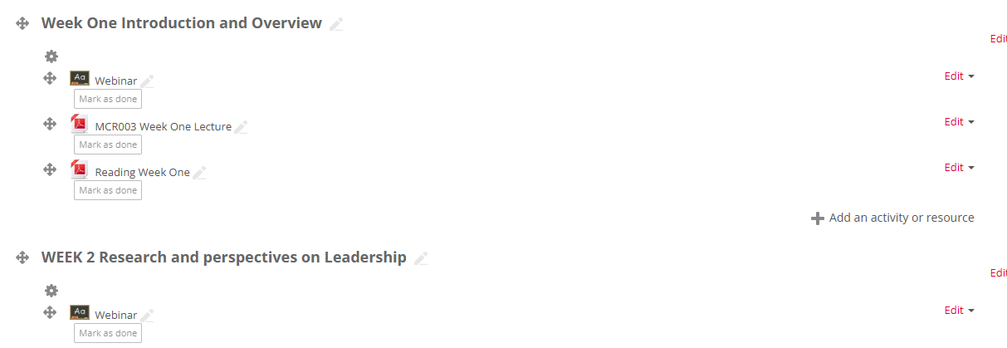
How to attend Online subject/class
Log into Moodle – choose your Subject – go to WEEK session and click “webinar”

Slide 22
Moodle
Please ensure you log on to Moodle for each subject you selected to start your subject learning
More detailed info can be found through your Student Central on the UBSS website.
https://www.ubss.edu.au/student-central/

Slide 23
Satisfactory Academic Progression
Attend all Lectures
Commit to the Subject
Submit assessment on time and complete all assessments successfully
Sufficient effort and time are essential
Read the UBSS policy on satisfactory Academic Progress

Slide 24
Academic & Learning Support
Academic and learning support is available through:
  Your Lecturer and facilitator (subject study, class learning, assessment, and results etc.)
  The Learning Support Coordinator (help/support academic/learning issues).
  Wilhelmina Woortman at Sydney campus: Wilhelmina.Woortman@ubss.edu.au
- Supporting students' academic growth and success
- Providing tailored learning assistance
  Associate Program Director - Subject and academic performance advise, course/subject learning support, and other academic/learning queries
  Senior Program Admin Coordinator - Subject selections support and other academic administration and student queries

Slide 25
Academic & Learning Support
UBSS online workshops (YouTube) for helping your learning and advancing your academic performance:
  Effective note taking in class - https://www.youtube.com/watch?v=c_Tbsuz_yjM
  Researching for an assignment - https://www.youtube.com/watch?v=SDpDcHHN8Ag
  Structuring an essay - https://www.youtube.com/watch?v=EnVBqfRiBBg
  Paragraphing in essay writing - https://www.youtube.com/watch?v=Ws1hCIJstpI
  Preparing a presentation - https://www.youtube.com/watch?v=OYb8qBjrruk
  Avoiding Plagiarism - https://www.youtube.com/watch?v=Kl3-LKnmK7M

Slide 26

Non academic Support Services
Manage:
  non-academic issues/query and deferment, reduce study load, credit transfers etc.
STUDENT SERVICES DEPARTMENT
Phone: 1300 422 422
Email: studentservices@gca.edu.au
Chat: www.ubss.edu.au
Or contact us via the UBSS Mobile App
Madilina Tresca
Manager, Academic Administration
Madilina.Tresca@ubss.edu.au

Slide 27
Credit Transfer
A maximum of eight (8) subjects may be awarded to MBA candidates with recently completed graduate or honors studies from a recognized tertiary institution that are directly relevant to core or specialized subjects.
Applications must be submitted by the end of 2nd week of your first trimester.
GCA Admissions Centre processes all applications.
GCA Admissions: admissions@gca.edu.au
Enquires: info@gca.edu.au Phone: 1300 422 422

Slide 28
Academic Integrity
Academic Integrity is valued at UBSS.
Academic misconduct at UBSS is overseen by the ACADEMIC INTEGRITY COMMITTEE that will apply penalties and sanctions for misbehavior.
Please ensure you are familiar with the ACADEMIC MISCONDUCT POLICY located on the UBSS website:
https://www.ubss.edu.au/media/5097/academic-misconduct-policy-v16.pdf

Slide 29
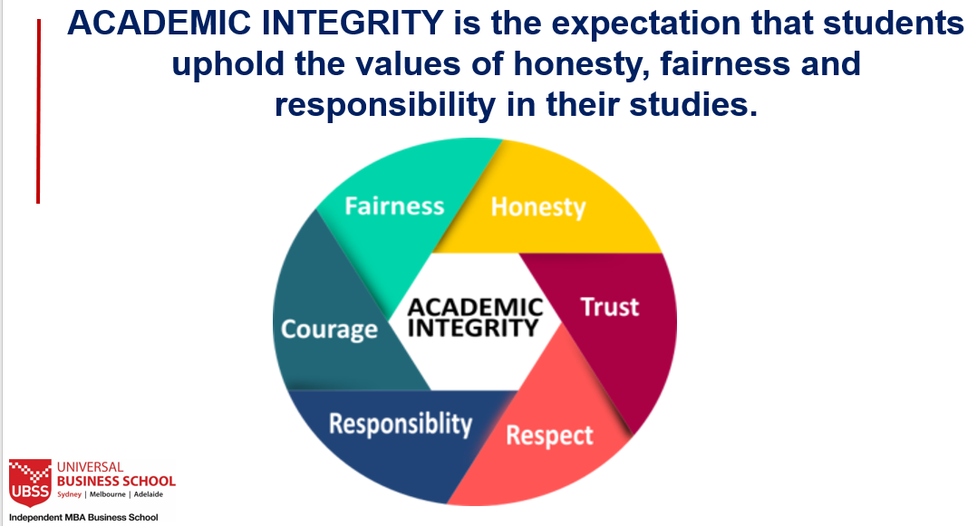
Academic Integrity

Slide 30
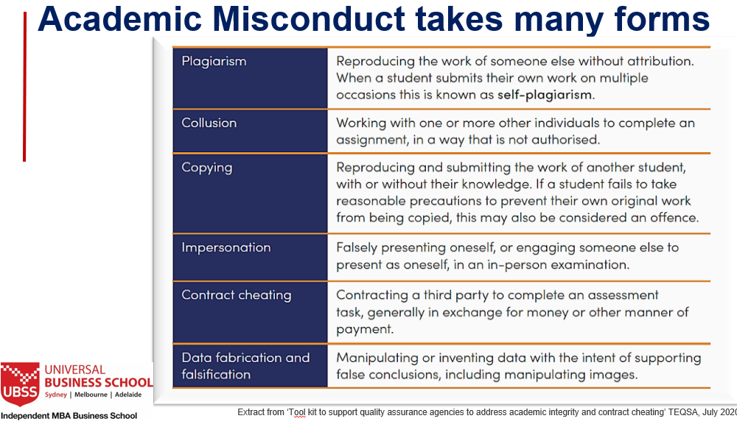
Academic Integrity

Slide 31

All the Best in your Studies and
Welcome to UBSS
Don’t forget to download your UBSS Mobile App and follow us on Social Media
www.ubss.edu.au

